Slide 1
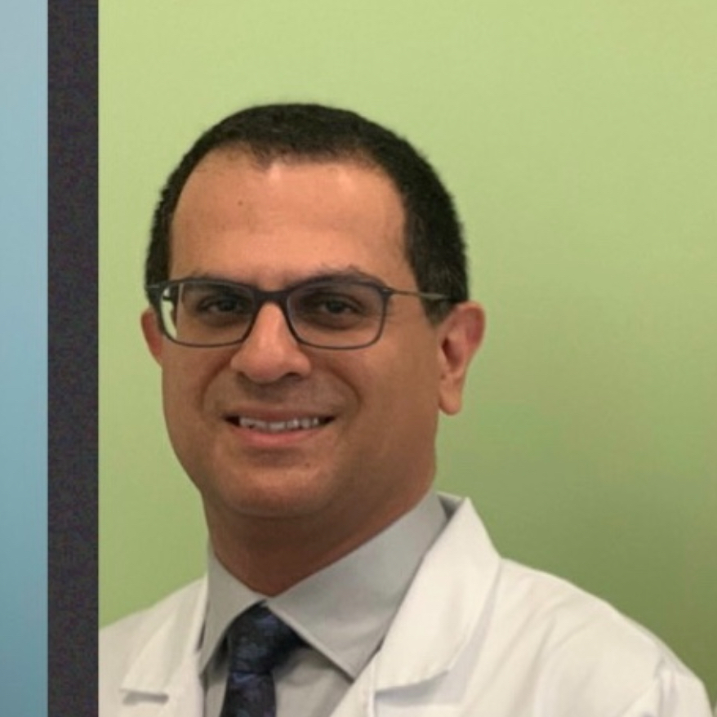
Lung Cancer Treatment Options
Dr. Navid Mokhtari, MD,
Medical Oncologist-Hematologist at Northern Virginia Hematology and Oncology Associates
Sunday, October 27th, 2024, at 2:00 pm EST

